Slide 1
Hands-on Session on MINLP
LSO-2026
Amit Vatsa
Associate Professor (OM&QT)
IIM Indore

Slide 2
Topics
Solving MINLPs with modern solvers
Convex MINLP: decomposition and outer-approximation ideas
  Kelley’s cutting plane
  Outer Approximation (OA)
  Generalized Benders Decomposition (GBD)
Non-convex MINLP:
  McCormick envelope
  Customized convexification
A real-world application

Slide 3
Where do MINLPs arise
Facility location and logistics with economies / diseconomies of scale
Process design and operation in chemical and petroleum industries
Capacity planning for cold storage, warehouses, and energy systems
Network design problems with discrete choices and nonlinear costs

Slide 4
What is convex optimization?
A problem is convex if:
  the feasible region is convex, and
  the objective is
    convex for a minimization problem, or
    concave for a maximization problem
Special case:
Linear programming is a convex optimization problem.

Slide 5
Some terminology
Convex Region: Given any two points A and B belonging to the region, if the line segment joining A and B is entirely within the region, the region is said to be convex.
Convex function: If the line segment connecting two points A and B on the graph of the function lies above the graph between A and B

Slide 6
Convex region

Slide 7
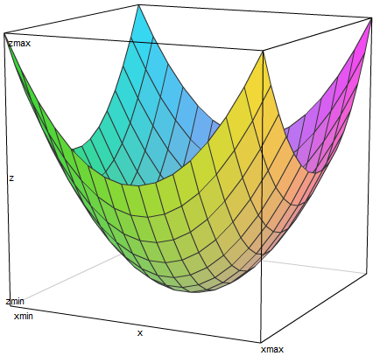
Convex function

Slide 8
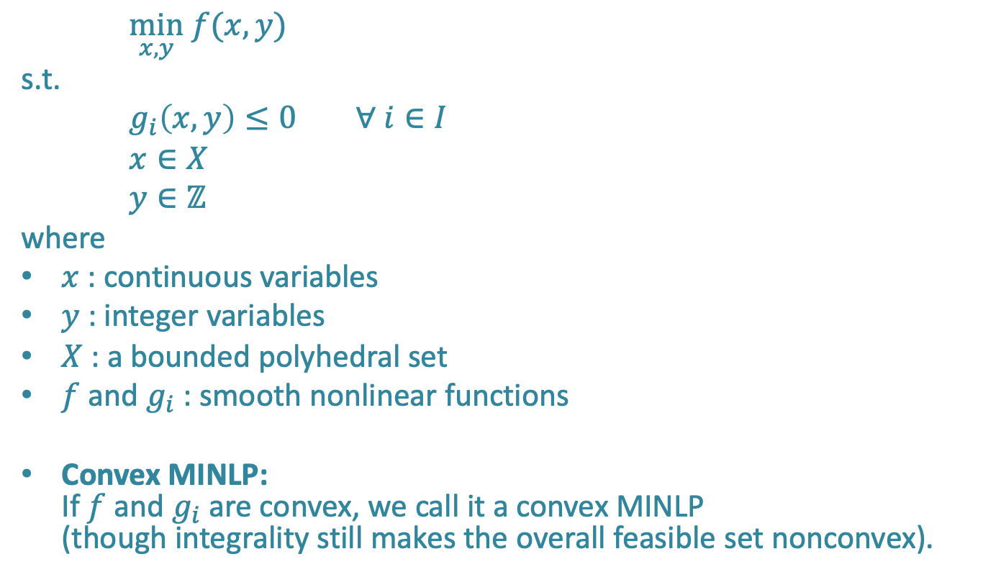
Generic MINLP form
$\min_{x,y} f(x,y)$
s.t.
$g_{i}\left(x,y\right)≤0 ∀ i∈I$
$x∈X$
$y∈ℤ$
where
$x$: continuous variables
$y$: integer variables
$X$: a bounded polyhedral set
$f$ and $g_{i}$: smooth nonlinear functions
Convex MINLP:
If $f$ and $g_{i}$are convex, we call it a convex MINLP
(though integrality still makes the overall feasible set nonconvex).

Slide 9
Can solvers solve MINLPs directly?
Yes, many models can be handled directly by modern solvers
Important classes include:
  MIQP / MIQCP / MISOCP
  Nonconvex quadratic and bilinear models
  General nonlinear constraints
Still, decomposition and convexification remain important for insight and scalability

Slide 10
Some MINLP solvers
Solver | License | Main strength
BARON | Commercial | Strong deterministic global optimization
Gurobi | Commercial | Very strong MILP/MIQP/MIQCP engine; spatial branch-and-bound for nonlinear models
SCIP | Open source | Strong academic open-source framework for constraint integer and nonlinear optimization
Knitro | Commercial | Excellent continuous NLP methods; MINLP support is strongest for convex models

Slide 11

Example 1: A convex MINLP
$$\min_{x,y}{x^{2}+y}$$
s.t.
$3x+2y≥8$ (1)
$x+2y≥6$ (2)
$$x,y≥0, x∈ℝ, y∈ℤ$$
This can be solved directly by Gurobi.

Slide 12
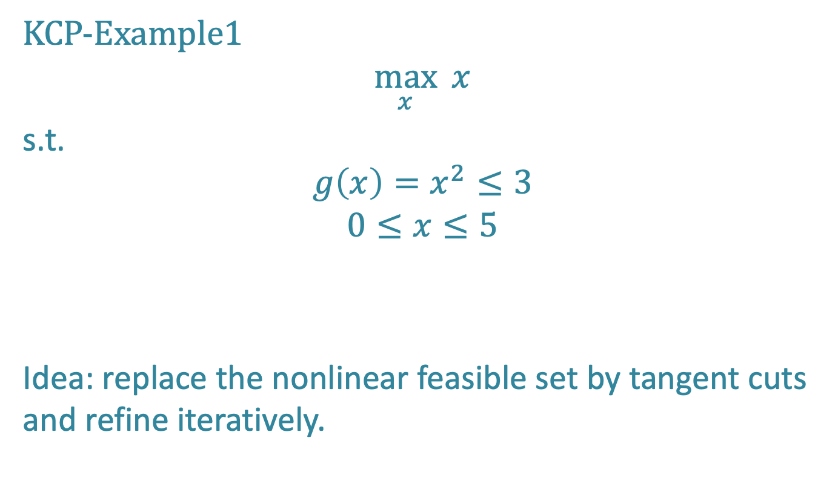
Kelley’s cutting plane: a precursor to OA
KCP-Example1
$$\max_{x}{ x}$$
s.t.
$$g\left(x\right)=x^{2}≤3$$
$$0≤x≤5$$
Idea: replace the nonlinear feasible set by tangent cuts and refine iteratively.

Slide 13
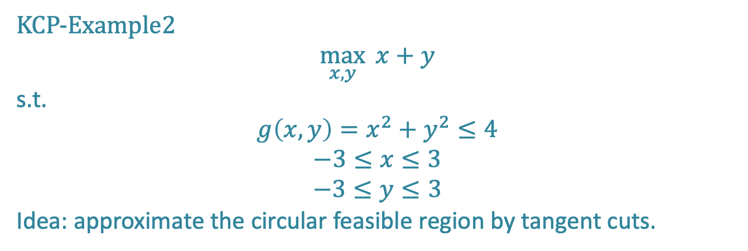
Kelley’s cutting plane
KCP-Example2
$$\max_{x,y}{ x+y}$$
s.t.
$$g\left(x,y\right)=x^{2}+y^{2}≤4$$
$$−3≤x≤3$$
$$−3≤y≤3$$
Idea: approximate the circular feasible region by tangent cuts.

Slide 14
Why discuss KCP in 21st century?
Not because it is the preferred method for solving convex NLPs today
But because it introduced a key idea for MINLP:
  tangent cuts are valid for convex constraints
  a few cuts may be enough; we do not need all supporting hyperplanes
Kelley is the conceptual precursor to OA and related decomposition methods.
Modern continuous NLP solvers: SQP, interior-point methods

Slide 15
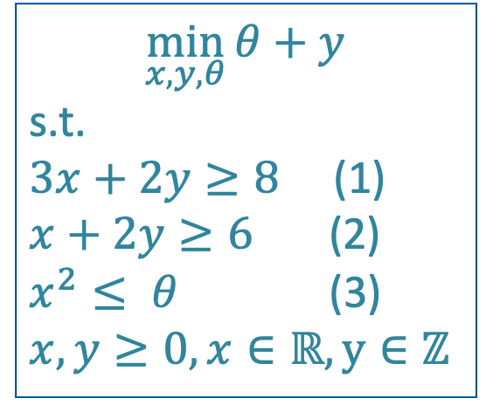
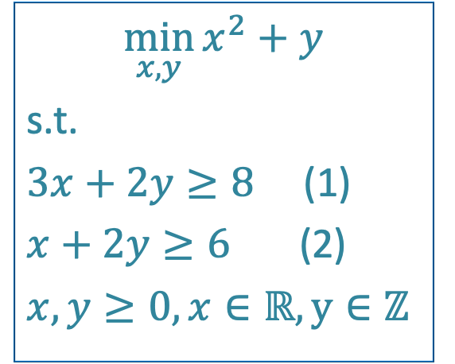
Example 1
$$\min_{x,y}{x^{2}+y}$$
s.t.
$3x+2y≥8$ (1)
$x+2y≥6$ (2)
$x,y≥0, x∈ℝ, y∈ℤ$
$$\min_{x,y,θ}{θ+y}$$
s.t.
$3x+2y≥8$ (1)
$x+2y≥6$ (2)
$x^{2}≤ θ$ (3)
$x,y≥0, x∈ℝ, y∈ℤ$

Slide 16
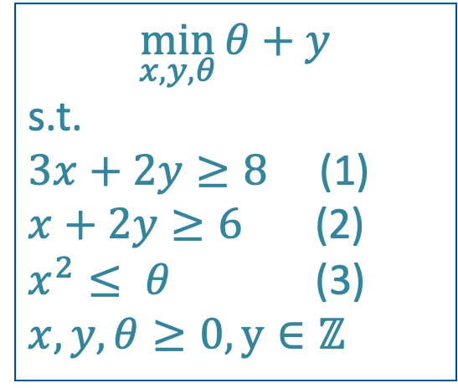
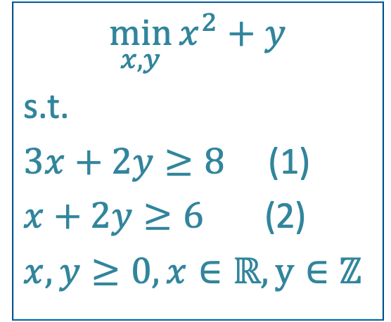
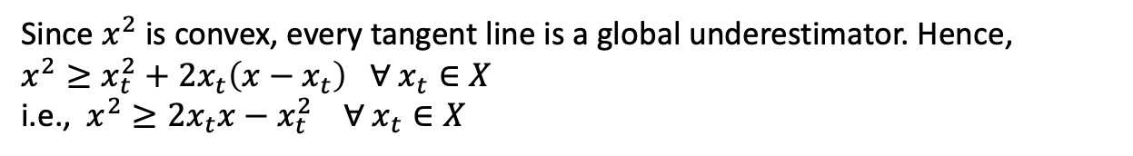
Example -1: OA-KCP (inefficient)
$$\min_{x,y}{x^{2}+y}$$
s.t.
$3x+2y≥8$ (1)
$x+2y≥6$ (2)
$x,y≥0, x∈ℝ, y∈ℤ$
$$\min_{x,y,θ}{θ+y}$$
s.t.
$3x+2y≥8$ (1)
$x+2y≥6$ (2)
$x^{2}≤ θ$ (3)
$x,y, θ≥0, y∈ℤ$
Since $x^{2}$ is convex, every tangent line is a global underestimator. Hence,
$x^{2}≥x_{t}^{2}+2x_{t}\left(x−x_{t}\right) ∀ x_{t}∈X$
i.e., $x^{2}≥{2x_{t}x−x}_{t}^{2} ∀ x_{t}∈X$

Slide 17
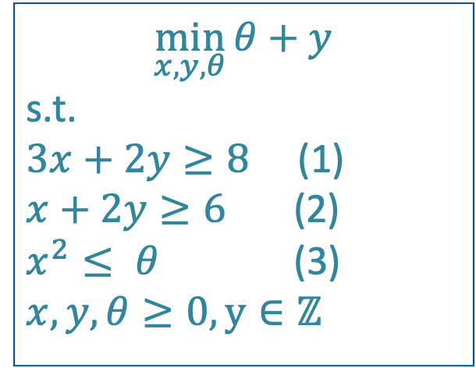


Example -1: OA-KCP (inefficient)
$$\min_{x,y}{x^{2}+y}$$
s.t.
$3x+2y≥8$ (1)
$x+2y≥6$ (2)
$x,y≥0, x∈ℝ, y∈ℤ$
$$\min_{x,y,θ}{θ+y}$$
s.t.
$3x+2y≥8$ (1)
$x+2y≥6$ (2)
$x^{2}≤ θ$ (3)
$x,y, θ≥0, y∈ℤ$
$${2x_{t}x−x}_{t}^{2}≤θ ∀x_{t}∈X (3^{′})$$
${2x_{t}x−x}_{t}^{2}≤$

Slide 18

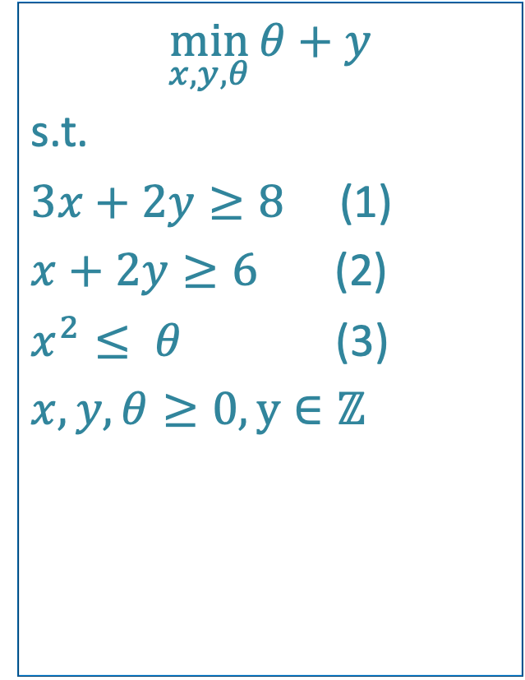

Method -1: OA-KCP (inefficient)
$$\min_{x,y,θ}{θ+y}$$
s.t.
$3x+2y≥8$ (1)
$x+2y≥6$ (2)
$x^{2}≤ θ$ (3)
$x,y, θ≥0, y∈ℤ$
Iteration 1: LB = 0,x = 6,y = 0,θ = 0,
UB = $x_{t}^{2}+y=36$
Cut added: $12x−36≤θ$
iteration 2: LB = 2,x = 3,y = 2,θ = 0,
UB = $x_{t}^{2}+y=11$
Cut added: $6x−9≤θ$
iteration 3: LB = 3,x = 1.5,y = 3,θ = 0,
UB = $x_{t}^{2}+y=5.25$
Cut added: $3x−2.25≤θ$
iteration 4: LB = 3,x = 0.75,y = 3,θ = 0,
UB = $x_{t}^{2}+y=3.5625$
Cut added: $1.5x−0. 5625≤θ$
iteration 5: LB = 3,x = 0.667,y = 3,θ = 0,
UB = $x_{t}^{2}+y=3.44$4
Cut added: $1.333x−0.444≤θ$
iteration 6: LB = 3.444,x = 0.667,y = 3,θ = 0.444
UB = $x_{t}^{2}+y=3.44$4
STOP as LB=UB
$${2x_{t}x−x}_{t}^{2}≤θ ∀x_{t}∈X (3^{′})$$

Slide 19

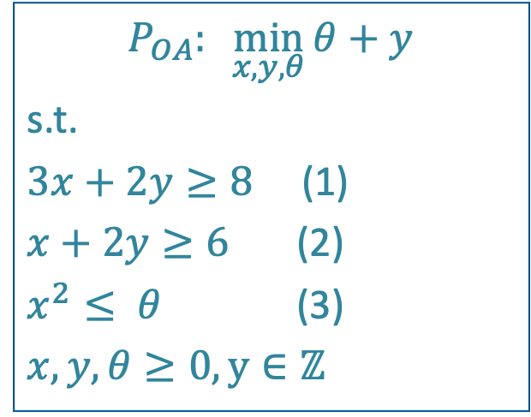
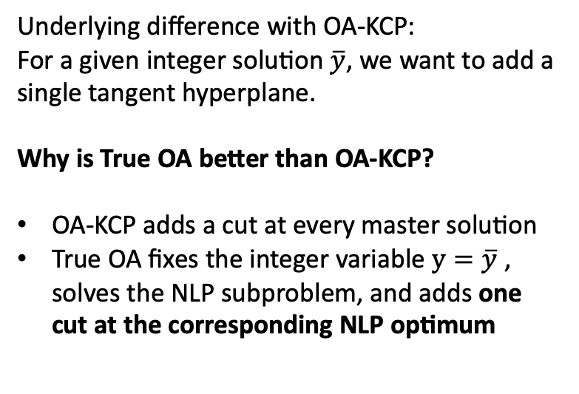
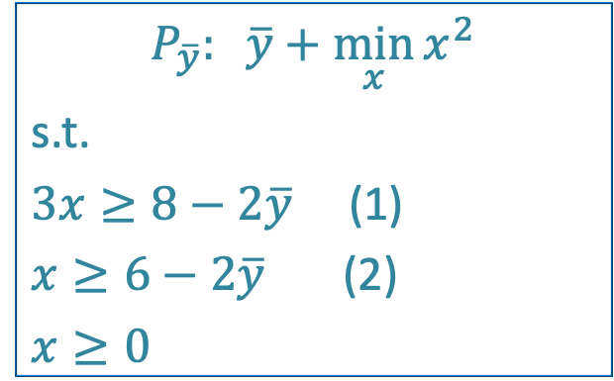
Method-2: True OA
$$P_{OA}:\min_{x,y,θ}{θ+y}$$
s.t.
$3x+2y≥8$ (1)
$x+2y≥6$ (2)
$x^{2}≤ θ$ (3)
$x,y, θ≥0, y∈ℤ$
Underlying difference with OA-KCP:
For a given integer solution $\overline{y}$, we want to add a single tangent hyperplane.
Why is True OA better than OA-KCP?
OA-KCP adds a cut at every master solution
True OA fixes the integer variable $y=\overline{y}$​, solves the NLP subproblem, and adds one cut at the corresponding NLP optimum
$${2x_{t}x−x}_{t}^{2}≤θ ∀x_{t}∈X (3^{′})$$
$$P_{\overline{y}}: \overline{y}+\min_{x}{x^{2}}$$
s.t.
$3x≥8−2\overline{y}$ (1)
$x≥6−2\overline{y}$ (2)
$x≥0$

Slide 20
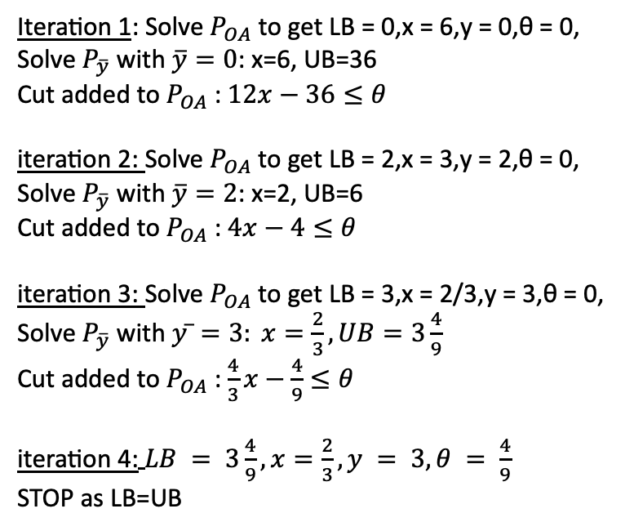
Method-2: True OA
$$P_{OA}:\min_{x,y,θ}{θ+y}$$
s.t.
$3x+2y≥8$ (1)
$x+2y≥6$ (2)
$x^{2}≤ θ$ (3)
$x,y, θ≥0, y∈ℤ$
Iteration 1: Solve $P_{OA}$ to get LB = 0,x = 6,y = 0,θ = 0,
Solve $P_{\overline{y}}$ with $\overline{y}=0$: x=6, UB=36
Cut added to $P_{OA}$: $12x−36≤θ$
iteration 2: Solve $P_{OA}$ to get LB = 2,x = 3,y = 2,θ = 0,
Solve $P_{\overline{y}}$ with $\overline{y}=2$: x=2, UB=6
Cut added to $P_{OA}$: $4x−4≤θ$
iteration 3: Solve $P_{OA}$ to get LB = 3,x = 2/3,y = 3,θ = 0,
Solve $P_{\overline{y}}$ with $y ̅=3: x=\frac{2}{3}, UB=3\frac{4}{9}$
Cut added to $P_{OA}$: $\frac{4}{3}x−\frac{4}{9}≤θ$
iteration 4:$LB = 3\frac{4}{9}, x=\frac{2}{3},y = 3,θ = \frac{4}{9}$
STOP as LB=UB
$${2x_{t}x−x}_{t}^{2}≤θ ∀x_{t}∈X (3^{′})$$
$$P_{\overline{y}}: \overline{y}+\min_{x}{x^{2}}$$
s.t.
$3x≥8−2\overline{y}$ (1)
$x≥6−2\overline{y}$ (2)
$x≥0$

Slide 21
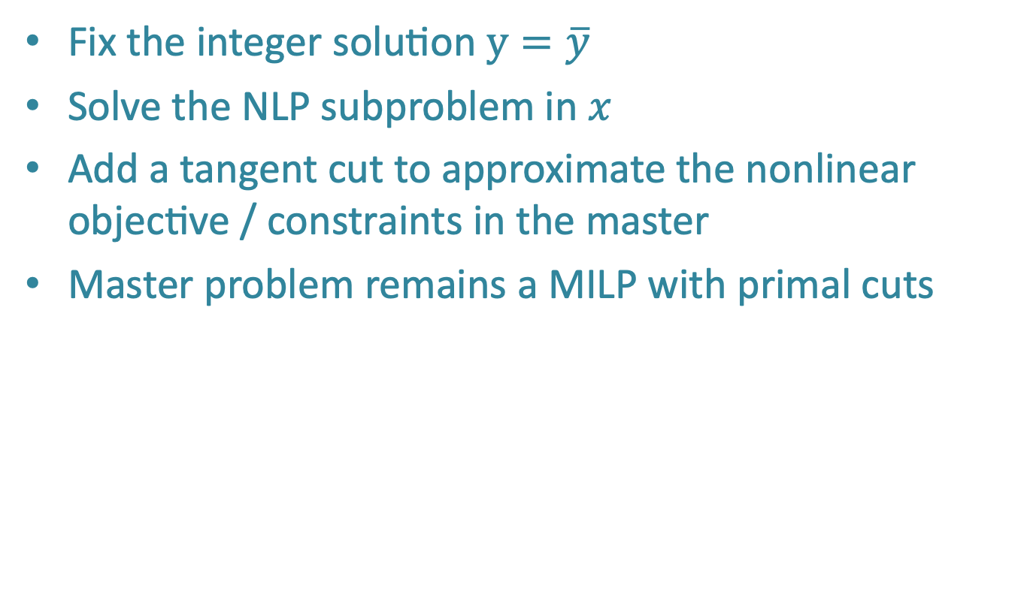
Outer Approximation (OA): key idea
Fix the integer solution $y=\overline{y}$​
Solve the NLP subproblem in $x$
Add a tangent cut to approximate the nonlinear objective / constraints in the master
Master problem remains a MILP with primal cuts

Slide 22
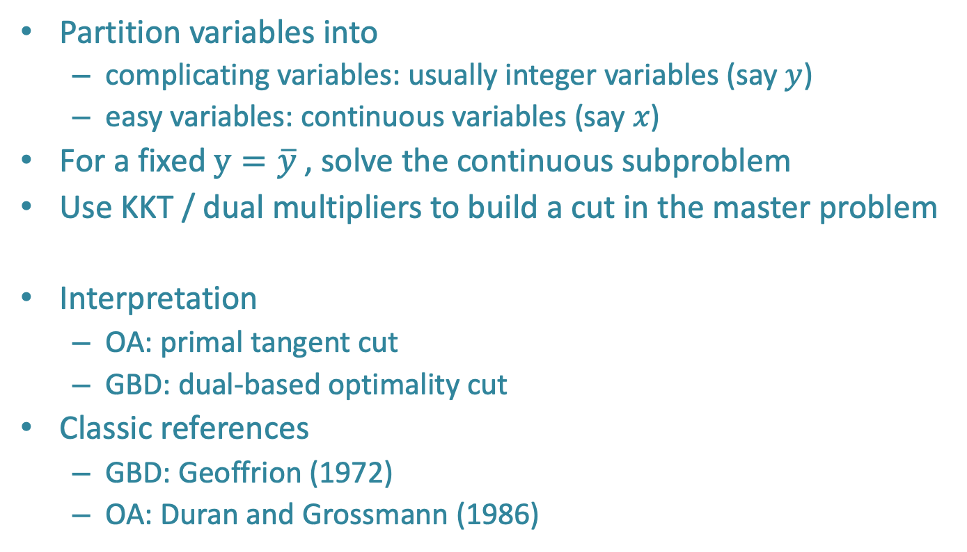
Generalized Benders Decomposition
Partition variables into
  complicating variables: usually integer variables (say $y$)
  easy variables: continuous variables (say $x$)
For a fixed $y=\overline{y}$​, solve the continuous subproblem
Use KKT / dual multipliers to build a cut in the master problem
Interpretation
  OA: primal tangent cut
  GBD: dual-based optimality cut
Classic references
  GBD: Geoffrion (1972)
  OA: Duran and Grossmann (1986)

Slide 23
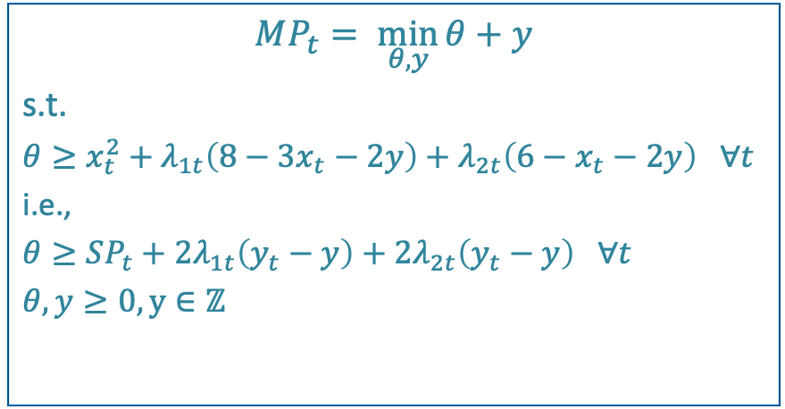
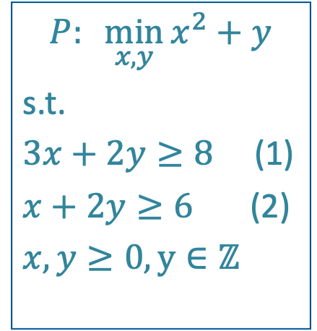
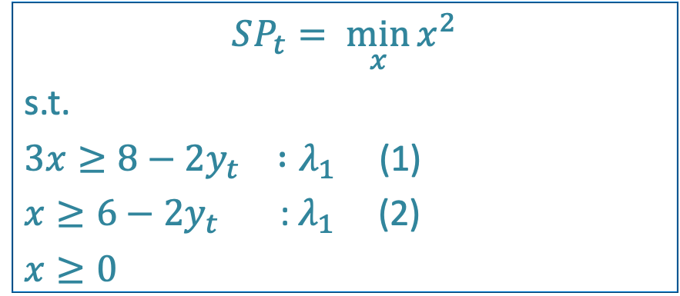
Generalized Benders Decomposition
$$P:\min_{x,y}{x^{2}+y}$$
s.t.
$3x+2y≥8$ (1)
$x+2y≥6$ (2)
$x,y≥0, y∈ℤ$
$$SP_{t}= \min_{x}{x^{2}}$$
s.t.
$3x≥8−2y_{t} :λ_{1}$ (1)
$x≥6−2y_{t}$ : $λ_{1}$ (2)
$x≥0$
$$MP_{t}= \min_{θ,y}{θ+y}$$
s.t.
$θ≥x_{t}^{2}+λ_{1t}\left(8−3x_{t}−2y\right)+λ_{2t}\left(6−x_{t}−2y\right)$ $∀t$
i.e.,
$θ≥SP_{t}+2λ_{1t}\left(y_{t}−y\right)+2λ_{2t}\left(y_{t}−y\right)$ $∀t$
$θ, y≥0, y∈ℤ$

Slide 24
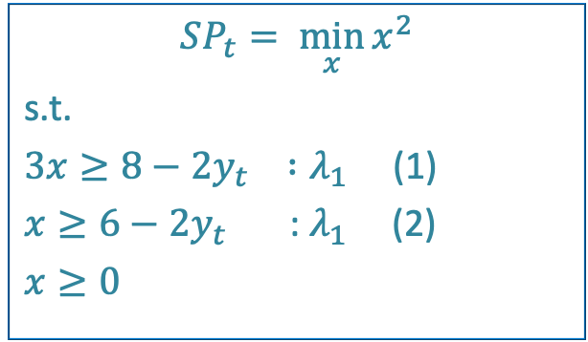
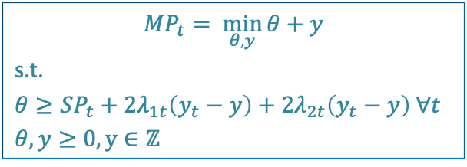
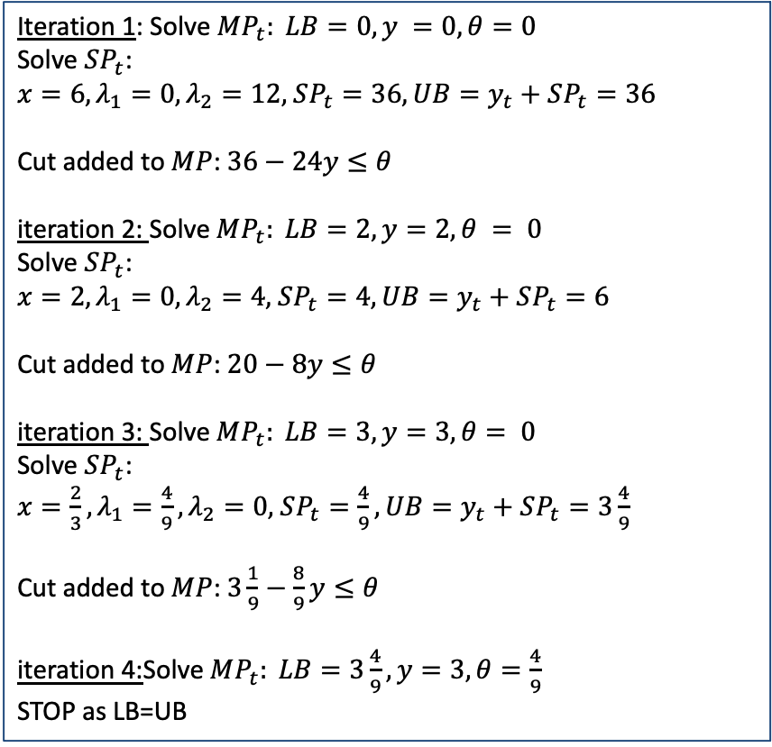
Generalized Benders Decomposition
$$MP_{t}= \min_{θ,y}{θ+y}$$
s.t.
$θ≥SP_{t}+2λ_{1t}\left(y_{t}−y\right)+2λ_{2t}\left(y_{t}−y\right) ∀t$
$θ, y≥0, y∈ℤ$
Iteration 1: Solve$MP_{t}: LB=0, y =0, θ=0$
Solve $SP_{t}$:
$x=6,λ_{1}=0,λ_{2}=12,$ $SP_{t}=36, UB=y_{t}+SP_{t}=36$
Cut added to $MP$: $36−24y≤θ$
iteration 2: Solve$MP_{t}: LB=2, y=2, θ = 0$
Solve $SP_{t}$:
$x=2,λ_{1}=0,λ_{2}=4,$ $SP_{t}=4, UB=y_{t}+SP_{t}=6$
Cut added to $MP$: $20−8y≤θ$
iteration 3: Solve$MP_{t}: LB=3, y=3, θ= 0$
Solve $SP_{t}$:
$x=\frac{2}{3},λ_{1}=\frac{4}{9},λ_{2}=0,$ $SP_{t}=\frac{4}{9}, UB=y_{t}+SP_{t}=3\frac{4}{9}$
Cut added to $MP$: $3\frac{1}{9}−\frac{8}{9}y≤θ$
iteration 4:Solve$MP_{t}: LB=3\frac{4}{9}, y=3, θ=\frac{4}{9}$
STOP as LB=UB
$$SP_{t}= \min_{x}{x^{2}}$$
s.t.
$3x≥8−2y_{t} :λ_{1}$ (1)
$x≥6−2y_{t}$ : $λ_{1}$ (2)
$x≥0$

Slide 25
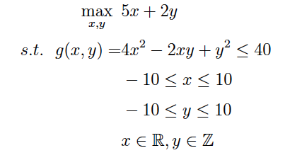
Example 2 (homework)
Problem from the Book: Amit Kumar Vatsa and Saurabh Chandra (2024), Exact and Approximation Methods for Mixed-Integer Nonlinear Programming Problem (Chapter 13)

Slide 26
Textbooks
Lee, J., & Leyffer, S. (Eds.). (2011). Mixed Integer Nonlinear Programming. Springer.
Nocedal, J., & Wright, S. J. (2006). Numerical Optimization (2nd ed.). Springer.
Bertsekas, D. P. (2016). Nonlinear Programming (3rd ed.). Athena Scientific.
Boyd, S., & Vandenberghe, L. (2004). Convex Optimization. Cambridge University Press.
Horst, R., & Tuy, H. (1996). Global Optimization: Deterministic Approaches (3rd ed.). Springer.

Slide 27
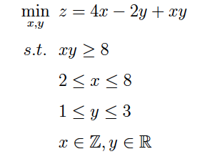
Non-Convex MINLPs (McCormick envelope)

Slide 28
Real-world application: shared wastewater treatment planning
Industrial clusters often contain many similar processing units
(e.g., Tirupur, Unnao)
Each unit generates effluent that must satisfy environmental norms
Large firms may install individual treatment plants
For MSMEs, shared/common effluent treatment plants (CETPs) are often more viable
Key planning questions
  Where should CETPs be located?
  What capacities should be installed?
  Which factories should be allocated to which CETP?
Why MINLP?
  discrete location and allocation decisions
  nonlinear treatment cost structure due to scale and pollutant concentration
Reference
Chandra, Sarkhel, and Vatsa (2021), Computers & Operations Research

Slide 29





Thank You
Prof. Amit Vatsa amitv@iimidr.ac.in

